Slide 1
AWS lambda

Slide 2
Understanding AWS lambda
AWS Lambda is a serverless compute service that allows you to run code without provisioning or managing servers. It automatically scales your applications by running code in response to events, making it an ideal solution for building microservices, data processing, and real-time file processing. This document will delve into the details of AWS Lambda, including its features, benefits, and a practical example to illustrate its functionality.
Step-1) Sign up for an AWS account
Step-2) After you sign up for an AWS account, secure your AWS account root user, enable AWS IAM Identity Center, and create an administrative user so that you don't use the root user for everyday tasks.

Slide 3
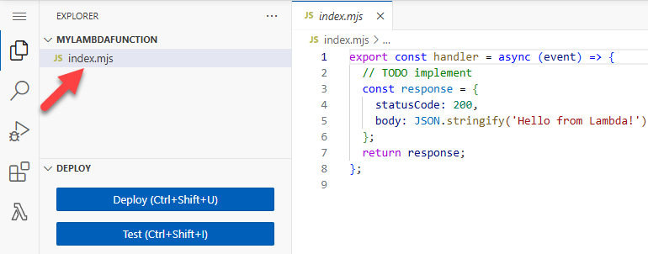
Step-3) Create a Lambda function with the console
To create a Hello world Lambda function with the console
Open the Functions page of the Lambda console.
Choose Create function.
Select Author from scratch.
In the Basic information pane, for Function name, enter myLambdaFunction.
For Runtime, choose either Node.js 22 or Python 3.13.
Leave architecture set to x86_64, and then choose Create function.
Step-4) To modify the code in the console
Choose the Code tab.
In the console's built-in code editor, you should see the function code that Lambda created. If you don't see the index.mjs tab in the code editor, select index.mjs in the file explorer as shown on the following diagram.

Slide 4
Step-5) Paste the following code into the index.mjs tab, replacing the code that Lambda created.
export const handler = async (event, context) => {
const length = event.length;
const width = event.width;
let area = calculateArea(length, width);
console.log(`The area is ${area}`);
console.log('CloudWatch log group: ', context.logGroupName);
let data = {
"area": area,
};
return JSON.stringify(data);
function calculateArea(length, width) {
return length * width;
}
};

Slide 5
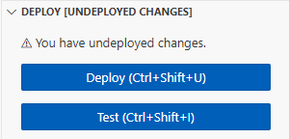
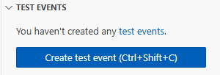
Step-6) In the DEPLOY section, choose Deploy to update your function's code:
Step-7) Invoke the Lambda function using the console code editor
To invoke your function using the Lambda console code editor, create a test event to send to your function. The event is a JSON formatted document containing two key-value pairs with the keys "length" and "width".
To create the test event
In the TEST EVENTS section of the console code editor, choose Create test event.

Slide 6
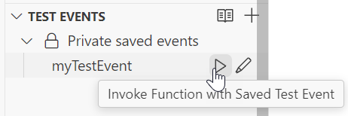
Step-8) enter the event name
In the event JSON section , replace the default JSON with the following
{
"length": 6,
"width": 7
}
Choose Save.
To test your function and view invocation records
In the TEST EVENTS section of the console code editor, choose the run icon next to your test event:

Slide 7
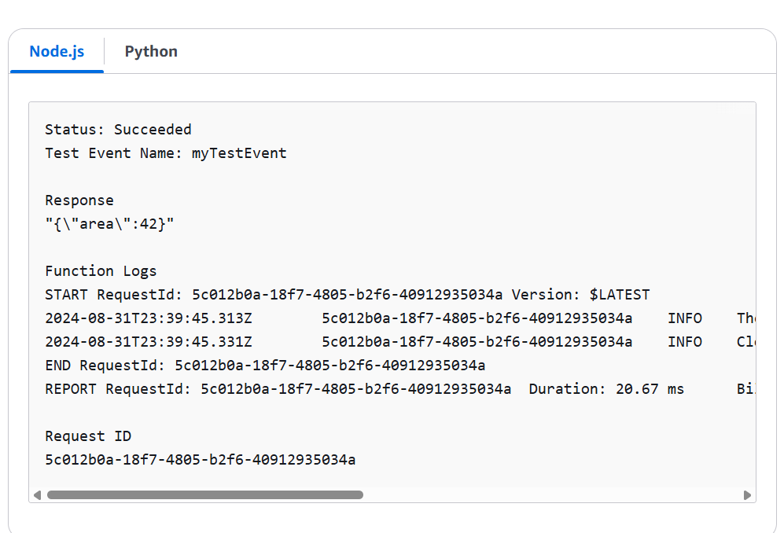
When your function finishes running, the response and function logs are displayed in the OUTPUT tab. You should see results similar to the following:

Slide 8
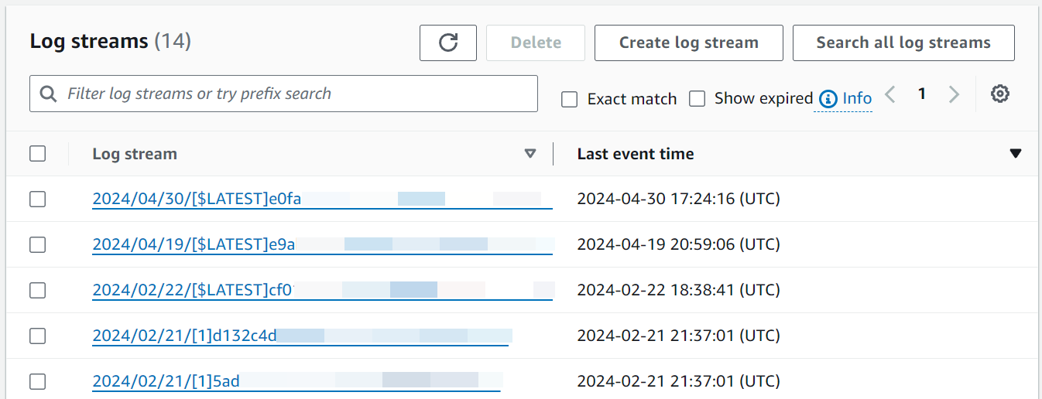
When you invoke your function outside of the Lambda console, you must use CloudWatch Logs to view your function's execution results.
To view your function's invocation records in CloudWatch Logs
Open the Log groups page of the CloudWatch console.
Choose the log group for your function (/aws/lambda/myLambdaFunction). This is the log group name that your function printed to the console.
Scroll down and choose the Log stream for the function invocations you want to look at.

Slide 9
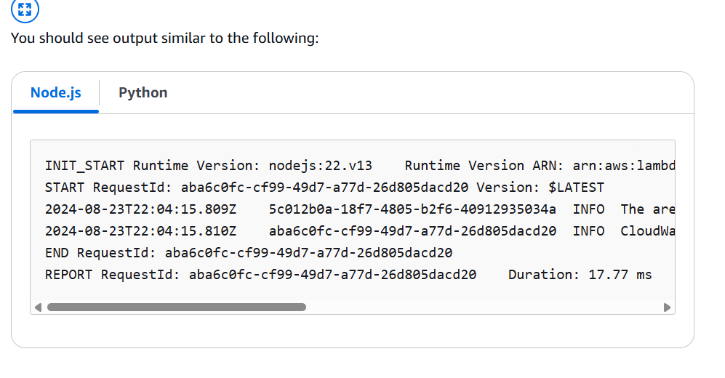

Slide 10
